Slide 1
Zika in Texas
Obstetrics and Neonatal Care Coordination Related to Infectious Diseases in Pregnancy
January 22, 2018
Austin, Texas
Jennifer A. Shuford, MD, MPH
Imelda Garcia, MPH
Texas Department of State Health Services

Slide 2
Objectives
Summarize the epidemiology of Zika
Review recent Texas and United States Zika case counts
Source: http://i2.cdn.turner.com/cnnnext/dam/assets/160202092019-07-zika-forest-large-169.jpg
www.cdc.gov

Slide 3
Issues Impacting Emerging Disease in Texas
Texas Geography
Binational border
Diverse geography and climate
Texas Population
Travel
Density
Socioeconomic status
Notes:
We’re an infectious disease frontier for the United States. We have numerous vulnerabilities for outbreaks. Unfortunately, we’ve been seeing proof of this almost every year.
We appreciate everything that the medical community has done to maintain vigilance against Ebola, chikungunya Chikayunga, West Nile, Middle Eastern Respiratory Syndrome (MERS), Highly Pathogenic Avian Influenza (HPAI), Chagas, and Ddengue Fever.
We’re holding this town hall to alert you to the immediate dangers posed by the Zika virus in our state and to seek your assistance in responding to this threat.
[photo of International Bridge in Brownsville]

Slide 4
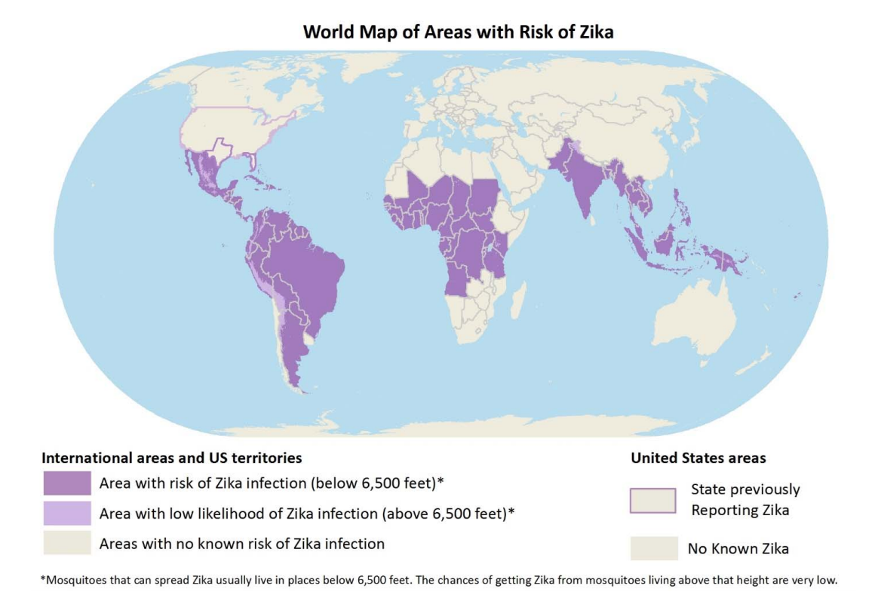
Areas with Risk of Zika Transmission
https://wwwnc.cdc.gov/travel/files/zika-areas-of-risk.pdf accessed on 12-29-17

Slide 5
Common Zika Symptoms
About 80% of Zika infections are subclinical
The most common symptoms of Zika are
Fever
Rash
Joint pain
Red eyes
Other symptoms include:
Muscle pain
Headache
Symptoms can last for several days to a week
Notes:
It’s Its impact on the general population is low and the symptoms are usually mild.

Slide 6
Zika Transmission
Notes:
Zika virus is a single-stranded RNA virus in the genus Flavivirus and is closely related to dengue, West Nile, Japanese encephalitis, and yellow fever viruses.
This virus is primarily transmitted by mosquitoes and we have a diagram here with the basic information about the transmission routes.
It is primarily transmitted by mosquito bites but can also be transmitted during sex, from a mother to baby in utero, and through blood transfusions.

Slide 7
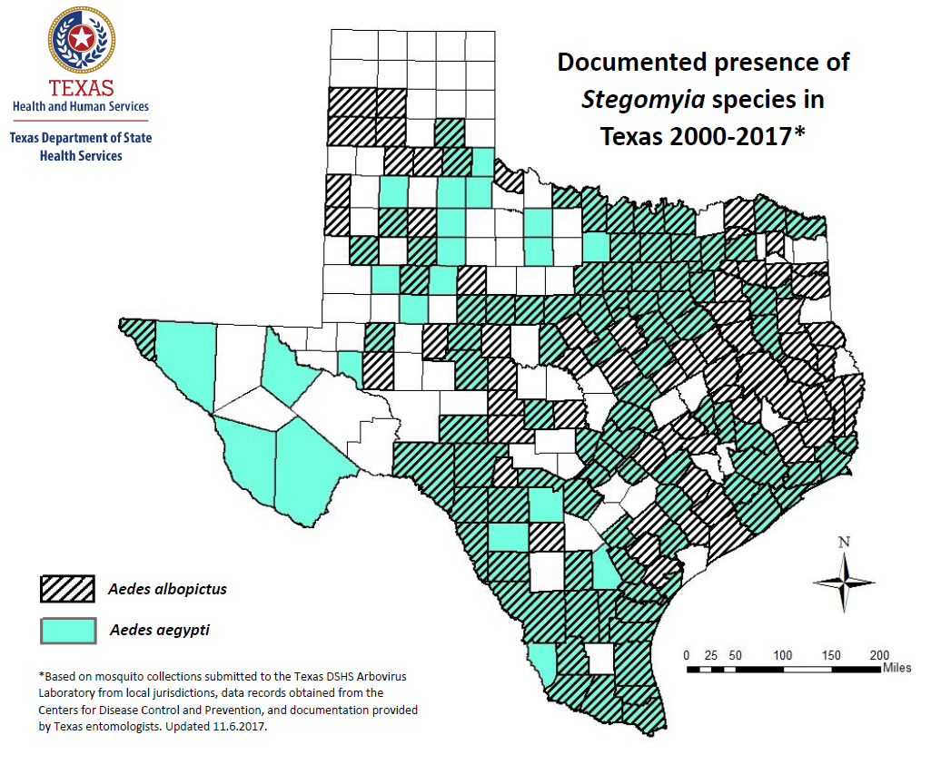

Slide 8
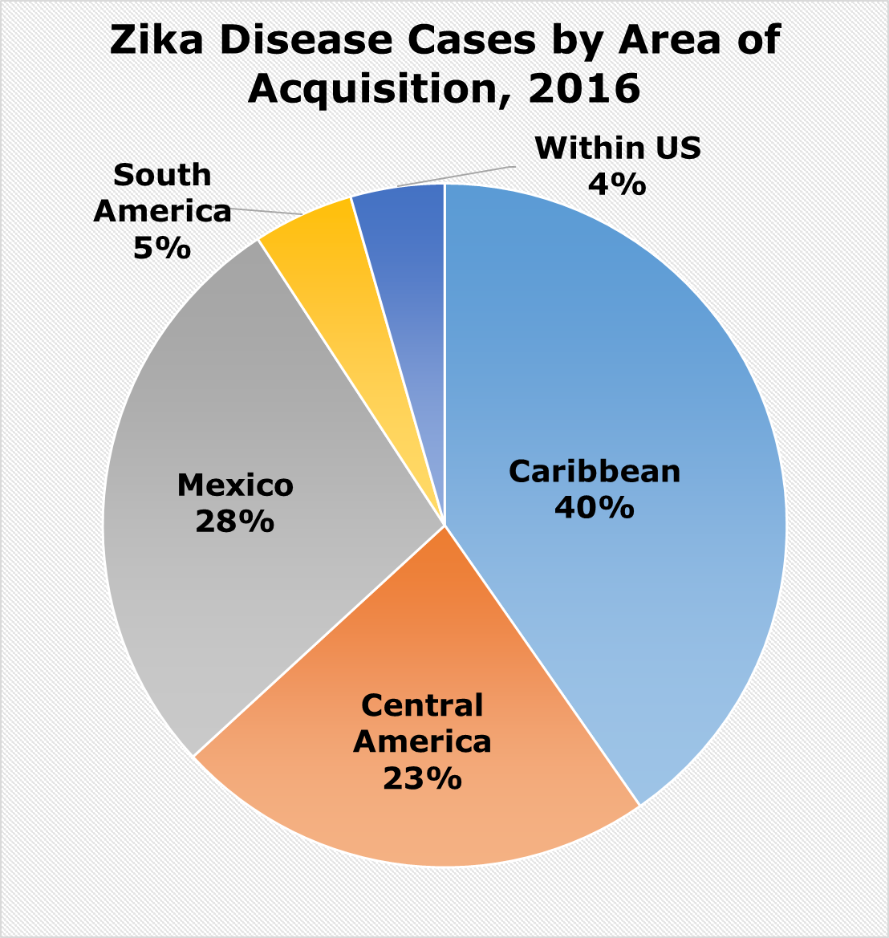
Zika Disease Cases in Texas, 2016

Slide 9
Zika Disease Cases by Health Service Region, 2016
N = 315

Slide 10
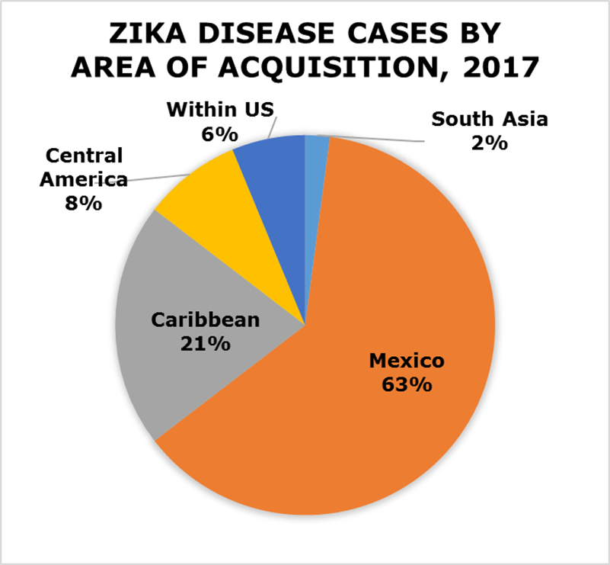
Zika Disease Cases in Texas, 2017

Slide 11
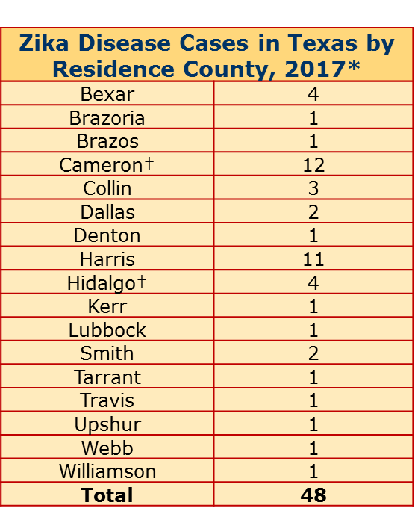
Zika Disease Cases in Texas, 2017
*as of close of business 1/17/18
All cases are travel associated except where otherwise noted.
† Includes cases transmitted by mosquitoes in Texas: Cameron(1), Hidalgo(1).

Slide 12
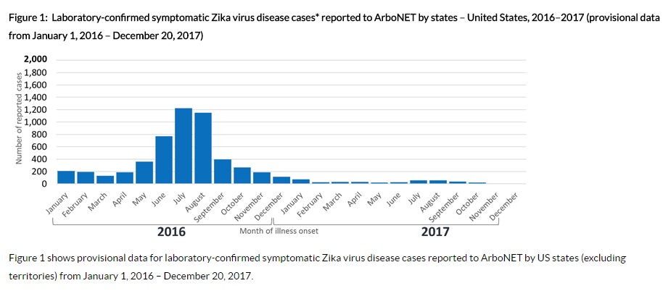
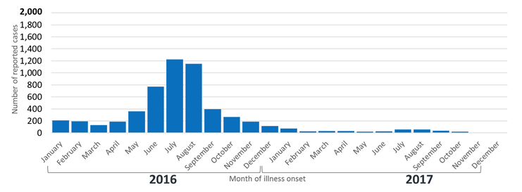
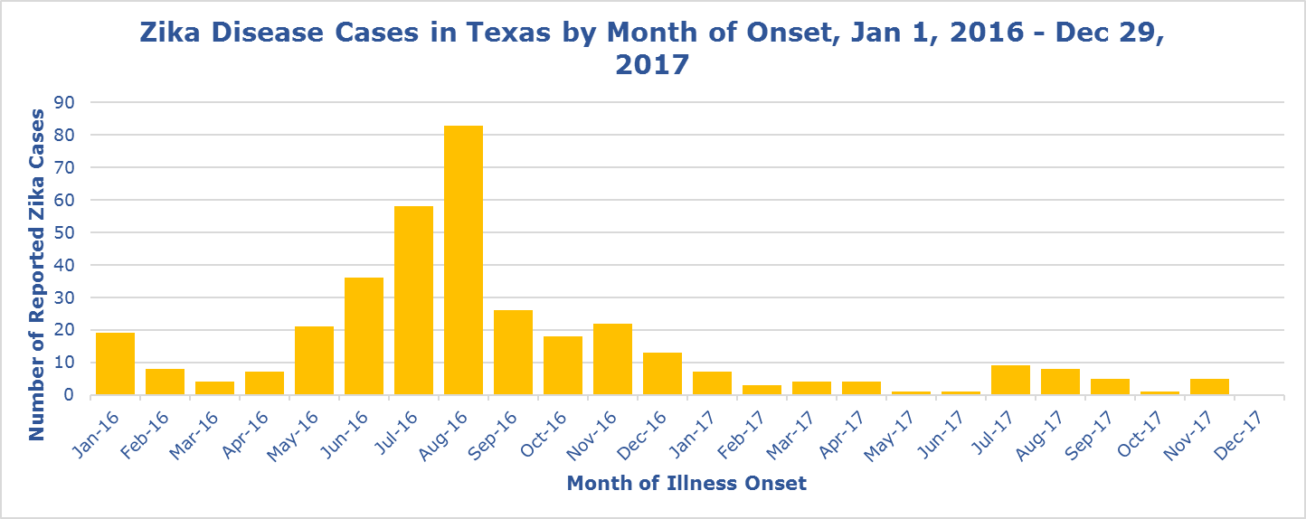
Zika Disease Cases by Onset, 2016-2017: US and Texas
US data source: https://www.cdc.gov/zika/reporting/case-counts.html

Slide 13
Further Resources
Web resources for continuous updates
CDC: http://www.cdc.gov/zika/index.html
PAHO: http://www.paho.org/hq/
DSHS: http://www.texaszika.org/

