Slide 1
Zika-Associated Birth Defects Surveillance – Texas, 2016-2017.
Noemi B. Hall, Ph.D.
Notes:
Good morning. I will present data describing Zika- associated birth defects surveillance and the pregnancy outcomes.

Slide 2
Testing Outcomes and Birth Defect Status of Fetal Losses or Infants Delivered in Texas to Mothers with Evidence of Zika Infection during Pregnancy – as of December 22, 2017
 | Laboratory Testing Completed |  | Laboratory Testing Not Completed
 | Laboratory Evidence of Zika Infection | No Laboratory Evidence of Zika Infection |  | TOTAL
Has Birth Defect Consistent w/ Zika | 4 | 9 | 2 | 15
Has Other Birth Defects | 0 | 2 | 9 | 11
Has No Apparent Birth Defects | 8 | 76 | 109 | 192
TOTAL | 12 | 87 | 120 | 219
Notes:
To better understand the burden of Zika in pregnancy and to collect the appropriate data related to affected newborn outcomes, Texas DSHS established enhanced surveillance for Zika associated birth defects.. This effort identifies pregnancy outcomes with birth defects among women with laboratory evidence of Zika virus infection during pregnancy. The table presented here is updated and distributed monthly to our partners in public health. This table shows that…

Slide 3
Testing Outcomes and Birth Defect Status of Fetal Losses or Infants Delivered in Texas to Mothers with Evidence of Zika Infection during Pregnancy – as of December 22, 2017
 | Laboratory Testing Completed |  | Laboratory Testing Not Completed
 | Laboratory Evidence of Zika Infection | No Laboratory Evidence of Zika Infection |  | TOTAL
Has Birth Defect Consistent w/ Zika | 4 | 9 | 2 | 15
Has Other Birth Defects | 0 | 2 | 9 | 11
Has No Apparent Birth Defects | 8 | 76 | 109 | 192
TOTAL | 12 | 87 | 120 | 219
Notes:
The delivery/neonatal medical records of 219 pregnancy outcomes have been reviewed by Texas DSHS Birth Defects Epidemiology and Surveillance Branch staff to determine…

Slide 4
Testing Outcomes and Birth Defect Status of Fetal Losses or Infants Delivered in Texas to Mothers with Evidence of Zika Infection during Pregnancy – as of December 22, 2017
 | Laboratory Testing Completed |  | Laboratory Testing Not Completed
 | Laboratory Evidence of Zika Infection | No Laboratory Evidence of Zika Infection |  | TOTAL
Has Birth Defect Consistent w/ Zika | 4 | 9 | 2 | 15
Has Other Birth Defects | 0 | 2 | 9 | 11
Has No Apparent Birth Defects | 8 | 76 | 109 | 192
TOTAL | 12 | 87 | 120 | 219
Notes:
…birth defect status, which is presented in the rows. A pregnancy outcome can have a birth defect consistent with Zika, OR any other birth defect, OR no apparent birth defects.

Slide 5
Testing Outcomes and Birth Defect Status of Fetal Losses or Infants Delivered in Texas to Mothers with Evidence of Zika Infection during Pregnancy – as of December 22, 2017
 | Laboratory Testing Completed |  | Laboratory Testing Not Completed
 | Laboratory Evidence of Zika Infection | No Laboratory Evidence of Zika Infection |  | TOTAL
Has Birth Defect Consistent w/ Zika | 4 | 9 | 2 | 15
Has Other Birth Defects | 0 | 2 | 9 | 11
Has No Apparent Birth Defects | 8 | 76 | 109 | 192
TOTAL | 12 | 87 | 120 | 219
Notes:
Zika testing status, displayed in the columns, was determined either by the Zoonosis Control Branch or review of medical records by Birth Defects Staff. Zika testing status can either be Laboratory Testing Completed, or Laboratory testing INCOMPLETE. If Lab rtesting is completed, then the resulting interpretation shows either evidence of Zika infection OR NO Evidence of Zika Infection. So, let’s examine the numbers presented here…

Slide 6
Pregnancy Outcomes of Women with Evidence of Zika Virus Infection in Texas, 2016-2017
254
Pregnant women with evidence of Zika virus infection
Notes:
254 women in Texas with evidence of a possible Zika virus infection during pregnancy have been reported to US Zika Pregnancy Registry, as of December 22, 2017.

Slide 7
Maternal Demographics
207 known outcomes as of 11/3/2017
Maternal Race/Ethnicity | Cases, n = 207 | %
Non-Hispanic White | 5 | 2.4
Non-Hispanic Black | 5 | 2.4
Hispanic | 149 | 72.0
Asian | 1 | 0.5
Other | 2 | 1.0
Unknown | 45 | 21.7
Maternal Age at Birth | Cases, n = 202 | %
< 20 | 52 | 25.7
20 - 29 | 103 | 51.0
30 - 39 | 43 | 21.3
40+ | 4 | 2.0

Slide 8
Pregnancy Outcomes of Women with Evidence of Zika Virus Infection in Texas, 2016-2017
254
Pregnant women with evidence of Zika virus infection
219
Pregnancy outcomes reviewed by DSHS staff
Zika testing status known
Presence or absence of birth defects
Notes:
219 of these pregnant women are known to have reached pregnancy completion. Their pregnancy outcomes have a known status for Zika testing and presence or absence of birth defects.
Over the next few slides, we will summarize these pregnancy outcomes – by type, time, and place.

Slide 9
Completed Pregnancy Outcomes
219 known outcomes as of 12/22/2017
Pregnancy Outcomes | Cases, n = 219 | %
Live born | 213 | 97.3
Stillborn | 1 | 0.4
Fetal loss | 5 | 2.3
Notes:
This data shows that of the 219 completed pregnancies by December 27th 2017, 1 pregnancy ended with a stillbirth delivery, 5 pregnancies ended with a fetal loss, and the remainder ended with a live born infant.

Slide 10
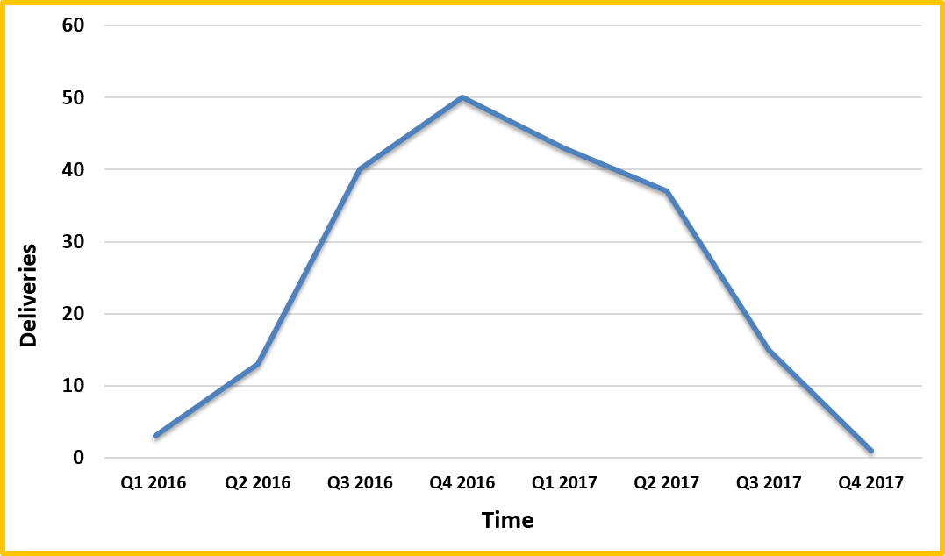
Deliveries to Women with Evidence of Zika Virus Infection in Texas, 2016-2017
Notes:
We see here these completed pregnancies over time, from January 2016 through November 2017 (so that the 4th Quarter of 2017 is not actually completed in this graph). The peak of deliveries appears to be from the 3rd quarter of 2016 through the 2nd quarter of 2017.

Slide 11
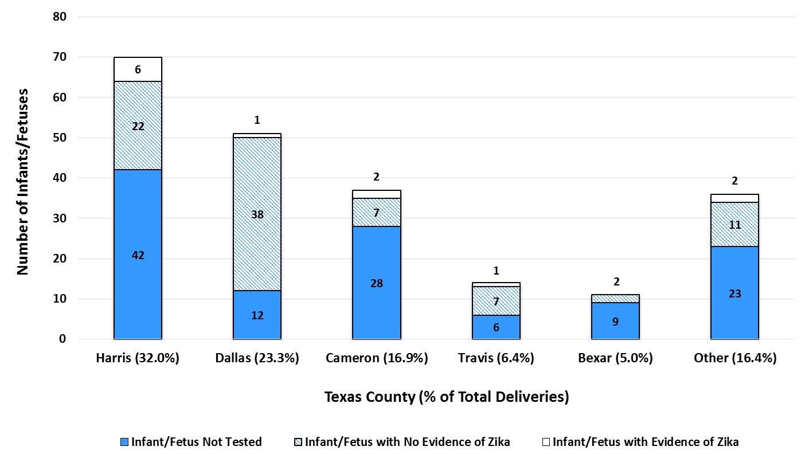
Infants/Fetuses Delivered by Mothers with Evidence of Zika Virus Infection During Pregnancy, by County and Infant’s Zika Testing Status, 12/22/2017
Notes:
Here, the completed pregnancies are displayed by county. The top five counties in Texas with the highest count of completed pregnancies are displayed individually here, and we can see that Harris and Dallas counties combined account for more than 50% of all the completed pregnancies of mothers with evidence of zika virus infection during pregnancy. The shading on the bars also indicates the infant’s testing status– solid blue for Incomplete Testing, striped blue for Tested, with No Evidence of Zika in the infant, and white for those infants who had complete testing and DID have evidence of Zika virus infection.

Slide 12
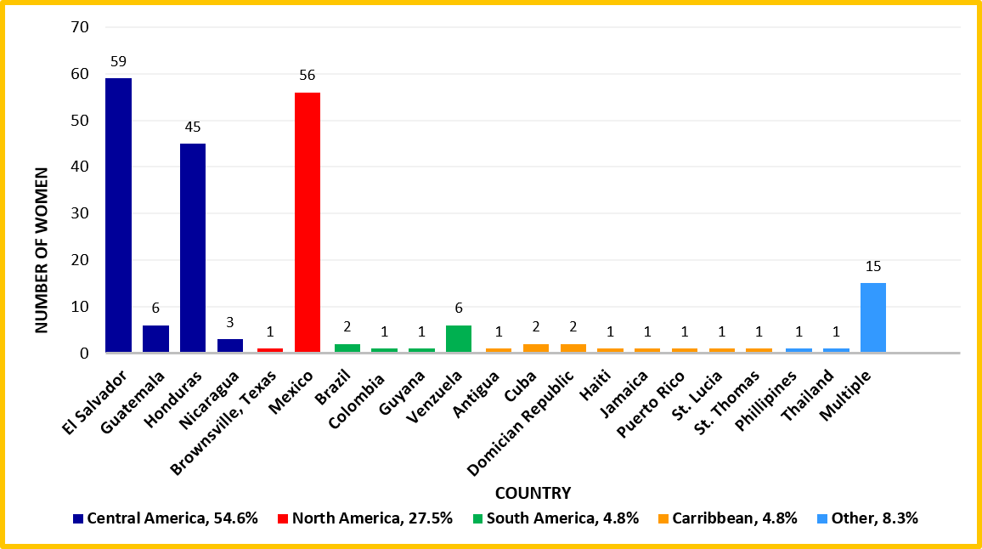
Travel History of Women with Evidence of Zika and Known Pregnancy Outcomes, Texas, as of 11/3/2017
Philippines
Dominican Republic
Notes:
This chart shows the reported travel history of 207 women who had evidence of zika infection during pregnancy AND who have a completed pregnancy as of November 3, 2017. This is significant as it demonstrates the region where the mother most likely was exposed to and acquired Zika virus infection. More than half of these mothers had travel history in Central America, namely El Salvador and Honduras. Another 27% of the mothers reported travel primarily to Mexico.

Slide 13
Pregnancy Outcomes of Women with Evidence of Zika Virus Infection in Texas, 2016-2017
254
Pregnant women with evidence of Zika virus infection
219
Pregnancy outcomes reviewed by DSHS staff
99
Infants with completed testing for Zika virus
Infant serum tested
Urine, placenta, other tissues
Notes:
So again, of the total 219 completed pregnancies as of December 22, 2017, 99 infants or fetal losses have had completed laboratory testing for evidence of Zika virus infection.
Each of these infants has had serum tested, with some also having other specimens tested, such as urine, placenta or other tissues.

Slide 14
Pregnancy Outcomes of Women with Evidence of Zika Virus Infection in Texas, 2016-2017
254
Pregnant women with evidence of Zika virus infection
219
Pregnancy outcomes reviewed by DSHS staff
99
120
Infants with completed testing for Zika virus
Infants/fetal losses with incomplete testing for Zika virus
Notes:
However, 120 infants and fetal losses did not receive complete testing for Zika. Some of these may be explained by early pregnancy losses, incomplete or compromised specimen collected for testing (not enough material to test or material arriving at the wrong temperature), or the incorrect specimen was tested (for example, only placenta was tested). However, the majority have no reason provided for why testing was not completed.

Slide 15
Zika-Associated Birth Defects
in 15 of 219 Pregnancy Outcomes
 | Microcephaly | Other Brain Abnormalities | Other Zika-Associated Birth Defects | Testing Status
1 | ✓ | ✓ | ✓ | +
2 | ✓ | ✓ | ✓ | +
3 | ✓ | ✓ |  | +
4 | ✓ |  |  | +
5
6
7
8
9
10
11
12
13
14
15
Notes:
In total, of the 219 pregnancy outcomes of mothers with Zika virus infection during pregnancy, there were FIFTEEN total infants/fetal losses with Zika-related birth defects.
FOUR of these infants did have evidence of Zika virus infection during pregnancy. These four each had microcephaly, with three having additional co-occurring birth defects: either other brain abnormalities OR other Zika- associated birth defects, such as limb contractures or eye malformations.

Slide 16
Zika-Associated Birth Defects
in 15 of 219 Pregnancy Outcomes
 | Microcephaly | Other Brain Abnormalities | Other Zika-Associated Birth Defects | Testing Status
1 | ✓ | ✓ | ✓ | +
2 | ✓ | ✓ | ✓ | +
3 | ✓ | ✓ |  | +
4 | ✓ |  |  | +
5 | ✓ | ✓ | ✓ | $$∅$$
6 |  |  | ✓ | $$∅$$
7
8
9
10
11
12
13
14
15
Notes:
TWO of the fifteen did NOT have testing completed– one was a pregnancy loss with microcephaly and other co-occurring birth defects, including clubfoot and micrognathia (NOTE: Micrognathia is a condition in which the jaw is undersized) . The second infant had other Zika-associated birth defects of the eyes.

Slide 17
Zika-Associated Birth Defects
in 15 of 219 Pregnancy Outcomes
 | Microcephaly | Other Brain Abnormalities | Other Zika-Associated Birth Defects | Testing Status
1 | ✓ | ✓ | ✓ | +
2 | ✓ | ✓ | ✓ | +
3 | ✓ | ✓ |  | +
4 | ✓ |  |  | +
5 | ✓ | ✓ | ✓ | $$∅$$
6 |  |  | ✓ | $$∅$$
7 | ✓ | ✓ |  | -
8 | ✓ |  | ✓ | -
9 | ✓ |  |  | -
10 | ✓ |  |  | -
11 | ✓ |  |  | -
12 |  | ✓ |  | -
13 |  | ✓ |  | -
14 |  | ✓ |  | -
15 |  |  | ✓ | -
Notes:
The remaining NINE infants with Zika-associated birth defects did receive complete testing for Zika infection, and no evidence was found to show Zika infection. Five of these nine infants had microcephaly. There are a total of 15/219 (7%) pregnancy outcomes with birth defects consistent with zika infection during pregnancy. This is comparable to the national rate reported by the US Zika Pregnancy Registry of 5%.

Slide 18
Thank you.

Slide 19
Supplemental Slides

Slide 20
Enhanced Surveillance for
Zika-Associated Birth Defects
Arboviral Case Investigation Forms
Zoonosis Control Branch
CDC US Zika Pregnancy Registry
Laboratory Testing Reports
Local Health Departments
CDC Birth Defects Surveillance
Birth Defects Epi and Surv Branch
Providers/
Facilities
Regional Social Workers, DSHS
Vital Records Data
Notes:
To better understand the burden of Zika in pregnancy and to collect the appropriate data related to affected newborn outcomes, Texas DSHS established enhanced surveillance for associated birth defects to identify pregnancy outcomes with birth defects among women with laboratory evidence of Zika virus infection during pregnancy.

Slide 21
Enhanced Surveillance for
Zika-Associated Birth Defects
Arboviral Case Investigation Forms
Zoonosis Control Branch
CDC US Zika Pregnancy Registry
Laboratory Testing Reports
Local Health Departments
CDC Birth Defects Surveillance
Birth Defects Epi and Surv Branch
Providers/
Facilities
Regional Social Workers, DSHS
Vital Records Data
Notes:
This diagram shows the data flow to and through the Texas DSHS Birth Defects Epidemiology and Surveillance Branch.

Slide 22
Reported Maternal Travel Exposure
207 known outcomes as of 11/3/2017
Travel by Country | Cases, n = 207 | %
Multiple Countries | 15 | 7.2
Central America
El Salvador | 59 | 28.5
Guatemala | 6 | 2.9
Honduras | 45 | 21.7
Nicaragua | 3 | 1.4
South America
Brazil | 2 | 1.0
Colombia | 1 | 0.5
Guyana | 1 | 0.5
Venzuela | 6 | 2.9
Carribbean
Antigua | 1 | 0.5
Cuba | 2 | 1.0
Domician Republic | 2 | 1.0
Haiti | 1 | 0.5
Jamaica | 1 | 0.5
Puerto Rico | 1 | 0.5
St. Lucia | 1 | 0.5
St. Thomas | 1 | 0.5
North America
Brownsville, Texas | 1 | 0.5
Mexico | 56 | 27.0
Southeast Asia
Phillipines | 1 | 0.5
Thailand | 1 | 0.5

Slide 23
Reported Maternal Travel Exposure (cont.)
207 known outcomes as of 11/3/2017
Travel by Region | Cases, n = 207 | %
Carribean | 10 | 4.8
Central America | 113 | 54.6
North America | 57 | 27.5
South America | 10 | 4.8
Southeast Asia | 2 | 1.0
Multiple Countries/Regions | 15 | 7.2

Slide 24
Completed Pregnancies Over Time
207 known outcomes as of 11/3/2017
Delivery Month* | Cases, n = 202 | %
Q1 2016 | 3 | 1.5
Q2 2016 | 13 | 6.4
Q3 2016 | 40 | 19.8
Q4 2016 | 50 | 24.8
Q1 2017 | 43 | 21.3
Q2 2017 | 37 | 18.3
Q3 2017 | 15 | 7.4
Q4 2017 | 1 | 0.5
*Q1 = January - March
Q2 = April - June
Q3 = July - September
Q4 = October – December

Slide 25
Demographics of Infants/Fetal Losses
207 known outcomes as of 11/3/2017
Infant Sex | Cases, n = 207 | %
Male | 98 | 47.0
Female | 82 | 40.0
Unknown | 27 | 13.0

Slide 26
Zika-related Birth Defects in 15 of 219 Pregnancy Outcomes
 | Microcephaly | Other Brain Abnormalities | Other Zika-related Birth Defects | Testing Status
1 | ✓ | ✓ | ✓ | +
2 | ✓ | ✓ |  | +
3 | ✓ |  |  | +
4 | ✓ | ✓ | ✓ | $$∅$$
5 |  |  | ✓ | $$∅$$
6 | ✓ | ✓ |  | -
7 | ✓ |  |  | -
8 | ✓ |  |  | -
9 |  | ✓ |  | -
10 |  | ✓ |  | -
Notes:
5 infants with zika related birth defects, one with microcephaly and a missing forebrain and two with only microcephaly noted. Two infants had other brain-related abnormailities including one infant with holoprosencephaly and ventriculomegaly, and one infant with hypoplasia of the ventral pons. These 5 infants had complete testing and did not show evidence of Zika virus infection through testing, though one infant only survived for 3 months past delivery.

Slide 27
Zika-Associated Birth Defects
in 15 of 219 Pregnancy Outcomes
 | Microcephaly | Other Brain Abnormalities | Other Zika-Associated Birth Defects | Testing Status
1 | ✓ | ✓ | ✓ | +
2 | ✓ | ✓ | ✓ | +
3 | ✓ | ✓ |  | +
4 | ✓ |  |  | +
Notes:
In total, of the 219 pregnancy outcomes of mothers with Zika virus infection during pregnancy, there were FIFTEEN total infants/fetal losses with Zika-related birth defects.

Slide 28
Zika-Associated Birth Defects
in 15 of 219 Pregnancy Outcomes
 | Microcephaly | Other Brain Abnormalities | Other Zika-Associated Birth Defects | Testing Status
1 | ✓ | ✓ | ✓ | +
2 | ✓ | ✓ | ✓ | +
3 | ✓ | ✓ |  | +
4 | ✓ |  |  | +
5 | ✓ | ✓ | ✓ | $$∅$$
6 |  |  | ✓ | $$∅$$
Notes:
As a result of enhanced surveillance, 254 women in Texas with evidence of a possible Zika virus infection during pregnancy have been reported to US Zika Pregnancy Registry, as of December 22, 2017.

