Slide 1
From Epidemiology to Clinical Care for Zika Coordination
Obstetrical and Neonatal Care Coordination related to Infectious Diseases in Pregnancy
January 22, 2018
Imelda Garcia, MPH
Jennifer Shuford, MD, MPH

Slide 2
Presentation Outline
Public Health Role & Responsibilities
Notifiable Conditions
Testing Recommendations
Public Health Response
Local transmission examples
Statewide prevention strategies
Zika Pregnancy Registry
Texas Zika funding
Role of Health Professionals
Summary

Slide 3
Public Health Roles & Responsibilities
State Statute
Local Health Departments
Local Health Authorities
Public Health Regions (DSHS)
DSHS statewide
Texas is a home-rule state
Texas Administrative Code-Notifiable Conditions
Coordination with local and regional public health entities across the state continues to be a key to quickly identifying and coordinating investigations and response activities for high consequence diseases

Slide 4
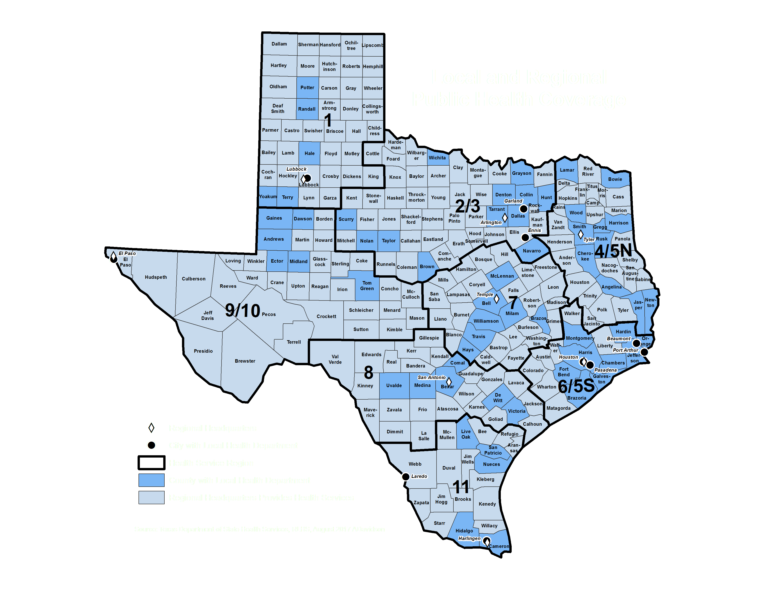

Slide 5
Notifiable Conditions
Texas Administrative Code outlines the conditions that must be reported to the state and the timelines in which reporting is required
Found Online at: http://www.dshs.texas.gov/idcu/investigation/conditions/
Check regularly as these are updated on an annual basis

Slide 7
Statewide Prevention Strategy Goals
Prevent/delay widespread local transmission of Zika in Texas
Protect pregnant women and their unborn children from the effects of Zika

Slide 8
Statewide Prevention Strategy Objectives
Prevent transmission of the Zika virus by identifying cases and facilitating or implementing vector control measures
Maximize education and outreach activities to the general public, local health departments (LHDs), and healthcare communities in Texas
Provide consistent, timely, and accurate information
Coordinate community response to include public health, healthcare, and emergency management
Facilitate and support public health and healthcare operations to include surveillance, laboratory diagnostics, and individual and community protections

Slide 9
Public Health Response
Begins with a positive lab report
Epidemiology Investigation
Determine exposure (travel, sexual, or local)
Onset of symptoms
Household testing if applicable
Integrated Vector Control:
Environmental assessments
Mosquito surveillance
Pesticide application based on assessment and mosquito data.
Education/Outreach to public and healthcare professionals
Increased/ongoing surveillance

Slide 10
Cameron County, 2016
November 2016: 6 local transmission cases
Conducted urosurvey in the surrounding neighborhood. Collected urine and serum on over 300 individuals residing in the area.
Also provided community education on the signs and symptoms and provided contact information to residents to call if situation changed.
Triggered enhanced year round mosquito surveillance and vector control
Lesson Learned: Community education was KEY!

Slide 11
Residents of the Lower Rio Grande Valley
Test all pregnant women with PCR and IgM concurrently
Once each trimester
At any stage of pregnancy if exhibiting symptoms
Test other people:
Who are residents of Cameron, Hidalgo, Kinney, Maverick, Starr, Val Verde, Webb, Willacy, or Zapata counties and
Exhibit a rash and
At least one other common Zika symptom, either fever, joint pain, or conjunctivitis
Preconception counseling is recommended for anyone contemplating having a baby

Slide 12
Other Areas of Texas
PCR and IgM concurrently
Test pregnant women (with or without symptoms):
Who have traveled or have a sexual partner who has traveled to a country (including Mexico) or area of Texas or the U.S. with ongoing Zika transmission
Who have no travel or sexual exposure, but exhibit three Zika symptoms
Test other people:
Who have traveled or have a sexual partner who has traveled to a country (including Mexico) or area of Texas or the U.S. with ongoing Zika transmission AND have one or more Zika symptoms
Who have no travel or sexual exposure, but exhibit three Zika symptoms
Preconception counseling is recommended for anyone contemplating having a baby

Slide 13
Public Health Communication & Coordination, 2017
Since the enhanced testing guidelines for the Lower Rio Grande Valley (LRGV), regular calls have occurred to go over:
Discuss positive lab reports,
Discuss details of pending investigations
Coordination with CDC on final PRNT testing results
Coordinate local vector control and mosquito testing

Slide 14
Hidalgo County, 2017
Due to enhanced screening of pregnant women, one (1) local transmission case identified.
Ongoing investigations are pending
Focus is on provider and community education
Enhanced mosquito surveillance and target vector control

Slide 15
National Zika Pregnancy Registry
Registry includes pregnant women with laboratory evidence of Zika infection and their infants, regardless of laboratory evidence
To be reported as a Zika disease or infection case , the pregnant woman must meet the criteria of the case definition
To fully characterize the range of ill effects of Zika virus on pregnancy, the registry casts a wider net and includes Zika disease and infection cases as well as those with lab evidence of infection with another flavivirus
Texas provides data to the Zika Pregnancy Registry weekly on any pregnant woman or newborn who receives care in Texas and who meet enrollment criteria
No other details will be provided about Texas pregnancies reported to the CDC due to privacy concerns and that it is not warranted from a public health standpoint
Notes:
After you report your Zika cases to the local or state regional health departments, DSHS will send the investigational information to the CDC Zika Pregnancy Registry. The registry will track pregnant women and their children to discover the long term impact of Zika infections.
Note that the information is confidential.
There’s much we still don’t know about this virus and the data generated by the registry may help us develop a vaccine and learn how to combat the disease in the future.

Slide 16
National Zika Pregnancy Registry Continued
Currently over 200 infants are already enrolled in the registry
CDC will soon stop enrolling women and infants into the national registry
Infant follow-up will track from birth through 2 years of age

Slide 17
Zika Funding
Aligns with the Statewide Prevention Strategy
Local public health preparedness & response activities
Community education and outreach
Human/mosquito surveillance
Vector control
Pesticide resistance testing
Speciation mapping projects
Vector control application and supplies
Zika Pregnancy Registry activities
Care coordination of women and infants with Zika infection and/or congenital Zika syndrome

Slide 18
Role of Health Professionals
Recognize when to screen and test pregnant women
Test, evaluate, and follow-up infants with possible congenital Zika infection
Regularly check DSHS/CDC updates for proper testing and submission protocols
Promote protective measures and vector control
Prenatal counseling to prevent sexual transmission
Prenatal care providers share appropriate medical information with professionals who care for newborn
Coordinate with public health authorities
Notes:
Here is the list of what I’m asking of you:
Throughout the upcoming mosquito season, please continue to stay abreast of the status of Zika in Texas and in your local communities.

Slide 19
Summary
Prevention is key!
Zika public health surveillance and response starts and ends with clinical care.
Keep informed on evolving testing recommendations.
Stay connected to your local public health authorities
Questions?

Slide 20
Thank you
ImeldaM.Garcia@dshs.texas.gov
Or
Jennifer.Shuford@dshs.texas.gov

