Slide 1
From Epidemiology to Clinical Care for Zika Coordination
Michael E. Speer, MD
Professor of Pediatrics & Medical Ethics
Notes:
Text
Text
Text
Text

Slide 2
Epidemiology
Zika virus first isolated from a rhesus monkey
Zika Forest Uganda (1947)
First human infection (1952)
Spread throughout Africa and Southeast Asia
Transmission via humans and other primates + mosquitos
Related to other flaviviruses
Dengue virus,
Chikungunya virus,
Yellow fever virus,
West Nile virus

Slide 3
Transmission
Bite of an infected mosquito
Maternal-fetal transmission
Sex (including vaginal, anal, and oral sex)
Blood product transfusion
Organ transplantation
Laboratory exposure

Slide 4
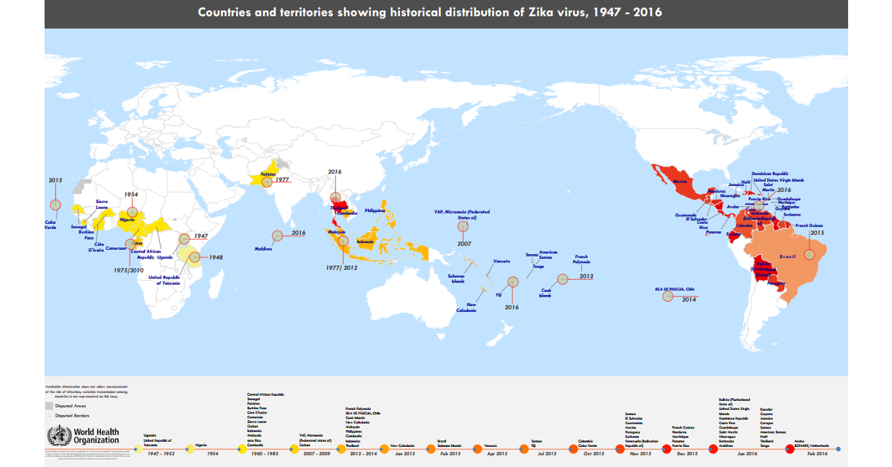
http://www.who.int/entity/emergencies/zika-virus/Zika-historical-distribution-social.png
Notes:
http://www.who.int/entity/emergencies/zika-virus/Zika-historical-distribution-social.png

Slide 5
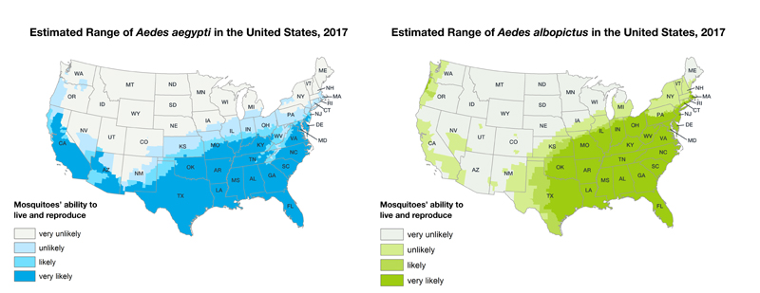
https://www.cdc.gov/zika/vector/range.html

Slide 6
Clinical Manifestations: Mother
Clinical manifestations: 20 to 25 percent
Low-grade fever (37.8 to 38.5°C),
Pruritic rash (erythematous macules and papules may be present on the face, trunk, extremities, palms, and soles),
Arthralgia (notably the small joints of hands and feet) & myalgia
Conjunctivitis (nonpurulent)
Similar symptoms in Chikungunya and Dengue Fever
MMWR Morb Mortal Wkly Rep 2016; 65:395.
Notes:
Thrombocytopenia, facial puffiness, palatal petechiae, uveitis, transient hearing impairment, myocarditis, and pericarditis have been described

Slide 7
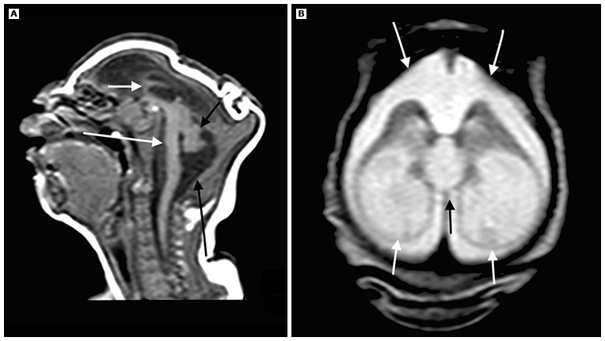
Clinical Manifestations: Fetus/Infant
Microcephaly: In-utero and ex-utero
Most common severe anomaly
MRI
BMJ 2016;353:i1901
Notes:
MRI of a newborn congenitally infected with Zika virus with associated severe microcephaly. Sagittal T1 weighted image (A) shows profound craniofacial disproportion, noticeably hypogenetic corpus callosum (short white arrow), and brainstem (long white arrow), hypoplasia of the cerebellum (short black arrow), and enlargement of the cisterna magna (long black arrow). Axial T2 weighted image (B) shows severe ventriculomegaly, mainly at the posterior horn and ventricular atrium (short white arrows). Note the bulging walls of the ventricle, the upward dilated third ventricle (black arrow), and enlargement of the subarachnoid space (long white arrows).

Slide 8
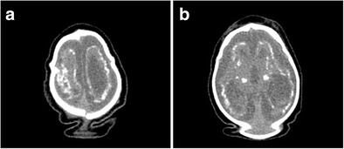
Clinical Manifestations: Fetus/Infant
Microcephaly: In-utero and ex-utero
Most common severe anomaly
CT Scan
Childs Nerv Syst (2016) 32: 1057
Notes:
Characteristic findings in the brain and spinal cord include thin cerebral cortices with enlarged ventricles and increased extra-axial fluid collections, intracranial calcifications particularly between the cortex and subcortex, abnormal gyral patterns, absent or hypoplastic corpus callosum, hypoplasia of the cerebellum or cerebellar vermis, and hypoplasia of the ventral cord (MMWR / October 20, 2017 / Vol. 66 / No. 41)

Slide 9
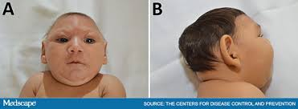
Clinical Manifestations: Fetus/Infant
Craniofacial disproportion – (ie, the face appears large in relation to the small head).
Cutis gyrate -
Craniosynostosis – Closed anterior fontanel at birth
Ocular abnormalities – Focal pigmentary retinal mottling, chorioretinal atrophy, and optic nerve abnormalities as well as microcornea, microphthalmia, cataracts and glaucoma
Small for gestational age – 30 to 40 percent of affected infants were SGA
MMWR / October 20, 2017 / Vol. 66 / No. 41
Notes:
More severe when mother infected in 1st/2nd trimester

Slide 10
Clinical Manifestations: Fetus/Infant
Hearing loss –7 percent had SNHL of varying severity and laterality
All children with hearing loss were among 44 children with severe microcephaly.
Diagnostic ABR
Arthrogryposis – Arthrogryposis and club foot are likely neurogenic in origin
Neuromotor abnormalities –Hypertonia, spasticity, hyperreflexia, irritability, dysphagia, and feeding difficulties
Seizures
MMWR / October 20, 2017 / Vol. 66 / No. 41
Notes:
Cardiac anomalies
Cardiac anomalies: primarily small non-clinically significant ASD VSD

Slide 11
Care Coordination
Maternal fetal medicine/Neonatology
Pediatric neurology/developmental follow-up
Pediatric ophthalmology
Radiology
Audiology
Pediatric infectious disease specialist
Diagnostic laboratory services
Mental health services
Genetics
Notes:
Also, Bright Futures, Early Childhood Intervention

Slide 12
Zika Care Connect:
Provider Referral Network – https://www.zikacareconnect.org/
Website – https://www.zikacareconnect.org/healthcare-professionals/healthcare-professional-resources/
HelpLine – HelpLine at 1-844-677-0447 (toll-free), or emailhelpline@zikacareconnect.org. Monday – Friday, 9 a.m. – 5 p.m. Eastern Time
Notes:
a network of specialists knowledgeable about and able to provide healthcare services for patients with Zika, aligned with CDC’s clinical guidance recommendations
searchable database of the Provider Referral Network, patient resource tools, and additional resources to promote linkage between maternal and pediatric services
staffed by professionals available to answer patient questions and assist patients in finding healthcare specialists that meet their needs

