Slide 7
Notes:
2022 Texas Maternal Mortality and Morbidity Review Committee (MMMRC) and Department of State Health Services (DSHS) jointly submitted their 2022 Biennial Report with recommendations to help reduce the incidence of pregnancy-related deaths and maternal morbidity in Texas.
Recommendations included: (talk through bullet points)
Recommendations really tied in well with the PPED project and it’s goals

Slide 10
Notes:
Diagram shows the development and initiation of the PPED project.
Planning workgroup developed the project plan and implementation process with input from Working Partners & Community Collaborators; also provides technical assistance and coordinates with TexasAIM on learning sessions.
OB Committee reviews documents developed by planning workgroup, providing feedback during monthly meetings, and assists with recruiting hospitals and communication with RAC-PCR alliance leadership
We’ll talk about the reinforcement hospitals and their role a bit later but these are the hospitals that enroll in the project; but they will be sharing what they learn and mentoring other TexasAIM hospitals not enrolled in the project, known as the Technical Assistance Cohort.

Slide 11
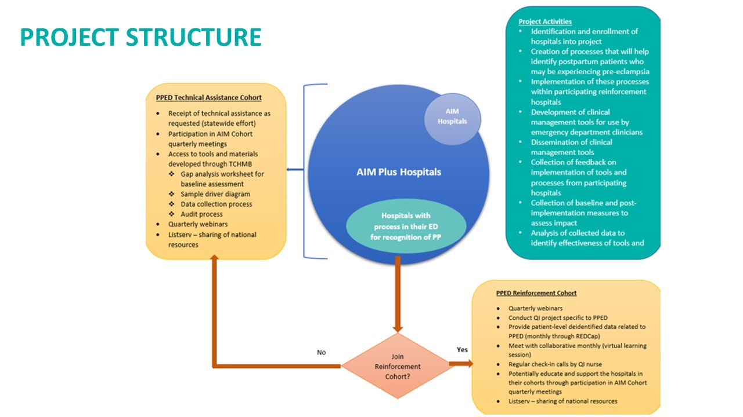
Notes:
Project will have two cohorts: a reinforcement cohort and a technical assistance cohort
Reinforcement cohort: made up of at least 1 hospital from each of the 22 Perinatal Care Region (PCR)-Regional Advisory Council (RAC) alliance regions. Participation not limited to one hospital per PCR/RAC
Image on slide shows the requirements of the PPED reinforcement cohort and project activities compared to the Technical Assistance Cohort. Reinforcement cohort project activities include quarterly webinars, monthly reinforcement calls, check-in calls with QI nurse and data submission of de-identified patient level and aggregate monthly data

Slide 12
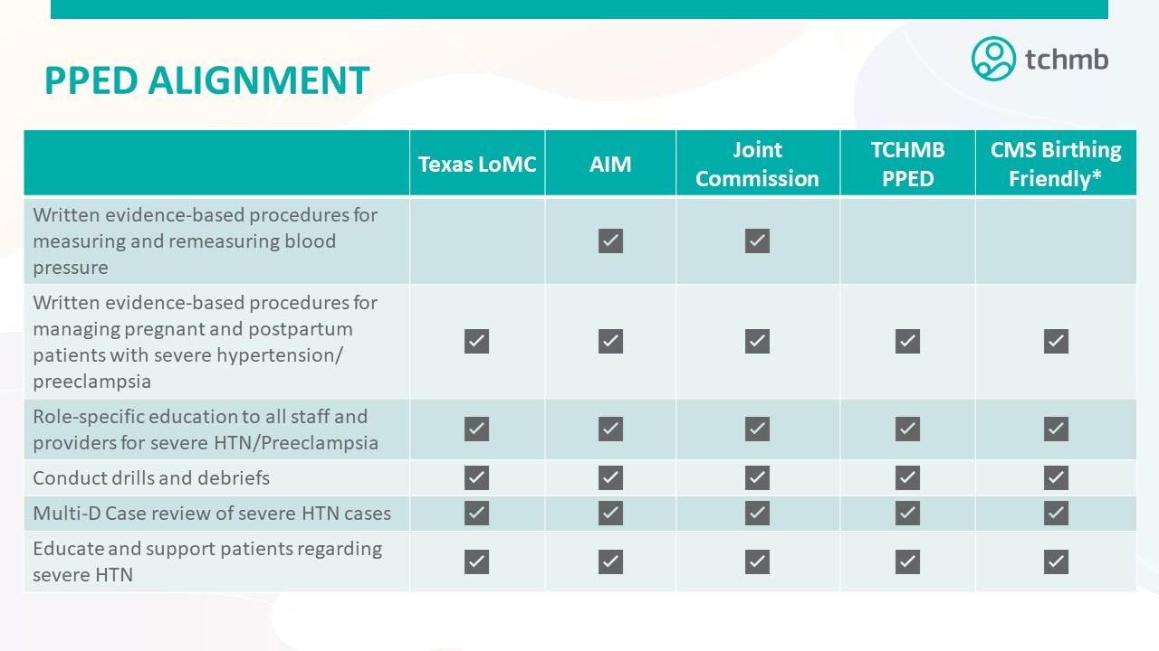
Notes:
- Table shows PPED project alignment with Texas Levels of Maternal Care, TexasAIM, The Joint Commission, and CMS Birthing Friendly designation

Slide 13
Notes:
Would like to focus specifically on the alignment between TexasAIM and PPED

Slide 14
Notes:
-

Slide 15
Mar
Apr
May
Jun
Notes:
PPED Action Periods (with PDSA) the findings incorporated into TexasAIM

Slide 17
Notes:
- Goal 5 of the project is to reduce racial disparities in health outcomes of Black postpartum patients with severe hypertension or preeclampsia. As a result, health equity will be a focus of the project.

Slide 22
Notes:
For the project, two outcome measures. One focused on screening all patients identified as positive for postpartum for elevated blood pressure and the second one focused on having joint case reviews between the ED and OB units for all postpartum patients with an elevated blood pressure (identified as SBP greater than or equal to 140 and or DBP greater than or equal to 90) in the emergency department
Next, three structure measures focused on policy and education of staff on the triage, consultation, admission, and treatment of patients presenting with an elevated blood pressure and symptoms of preeclampsia.
Final measures are process measures related to screening, treatment and transfer of postpartum patients with persistent severe range blood pressures, identified as SBP greater than or equal to 160 and or DBP greater than or equal to 110.
To align with health equity focus of the project, outcome and process measures will be disaggregated by Race, Ethnicity, Language, and geographic location

Slide 24
Notes:
Monthly aggregate and de-identified patient level data will be submitted via REDCap. As Lolly mentioned earlier during the discussion on project structure, the data submitted via REDCap is only for the TCHMB project and separate from any data collection done for TexasAIM.
Teams selected a technical leader/REDCap account holder(s) in the enrollment form and they will be given access to TCHMB’s redcap to enter the needed data.
They will receive an email from REDCap asking them to create an account. Once an account is created, they will receive two other emails giving them access to the monthly aggregate and the de-identified patient level data collection forms.
Once they have access, they will be able to go in and enter data in both forms each month.
Instructions on accessing REDCap and completing the data collection forms are included in the Data Measurement and Data Strategy Guide, will also be posted on the TCHMB project website and shared in the project basecamp site.
TCHMB staff also available during and outside of office hours to assist with any REDCap questions

Slide 25
Notes:
Hospitals submit data to TCHMB via REDCap
TCHMB staff clean and analyze the data, draft reports that track project progress, monitors outcomes, comparisons to the group at large in aggregate form
TCHMB shares the reports and data with RAC Perinatal committees and hospitals for purposes of quality improvement in the hospital/region
Hospitals and RACs can share data reports with each other
Now turn it over to Mercy, TCHMB Program Manager, who will walk us through REDCap

Slide 29
Notes:
- Registration is now open for TCHMB’s 2023 summit!
- Theme for the summit is Social Determinants of Health and how they impact maternal and neonatal health outcomes. There will be pre-summit sessions on the 15th focused on birth equity and quality improvement training.
Use the link posted in the chat to register or register for the summit on TCHMB’s website.

